Slide 1

Add title here
Add subtitle here
Member 1

Slide 2




Member of Group
Member 2
Member 3
Member 4
Member 5
Member 1

Slide 3

Add title here
Polaroid is a type of camera which uses self-developing film to create a chemically developed print shortly after taking the picture.
Member 5

Slide 4
Add title here
Polaroid is a type of camera which uses self-developing film to create a chemically developed print shortly after taking the picture.
Member 4

Slide 5
Member 1

Slide 6
Polaroid is a type of camera which uses self-developing film to create a chemically developed print shortly after taking the picture.
Member 1

Slide 7

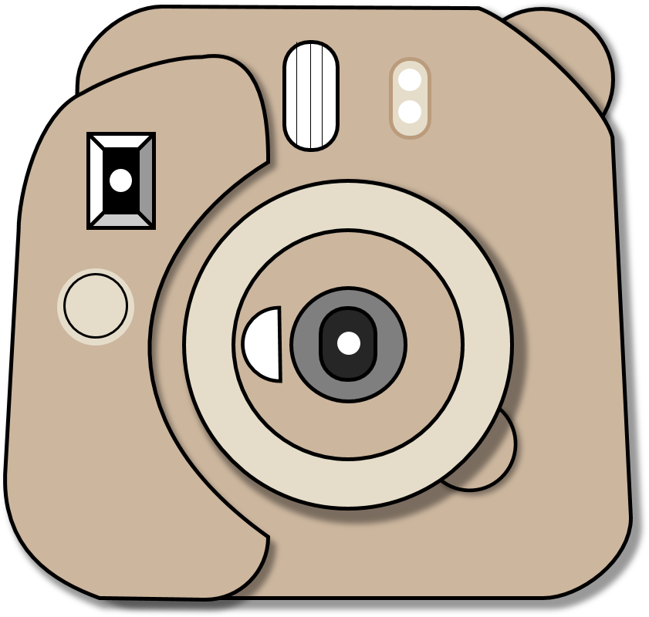
Add title here
Add subtitle...
Point 1
Point 2
Point 3
Point 4
Point 5
Point 6
Point 7
Point 8

Slide 8
Member 1
Member 3
Member 5
Member 2
Member 4

Slide 9
Polaroid is a type of camera which uses self-developing film.
Polaroid is a type of camera which uses self-developing film.
Polaroid is a type of camera which uses self-developing film.
Polaroid is a type of camera which uses self-developing film.
Member 5

Slide 10
Thank You

Slide 11


